Slide 1
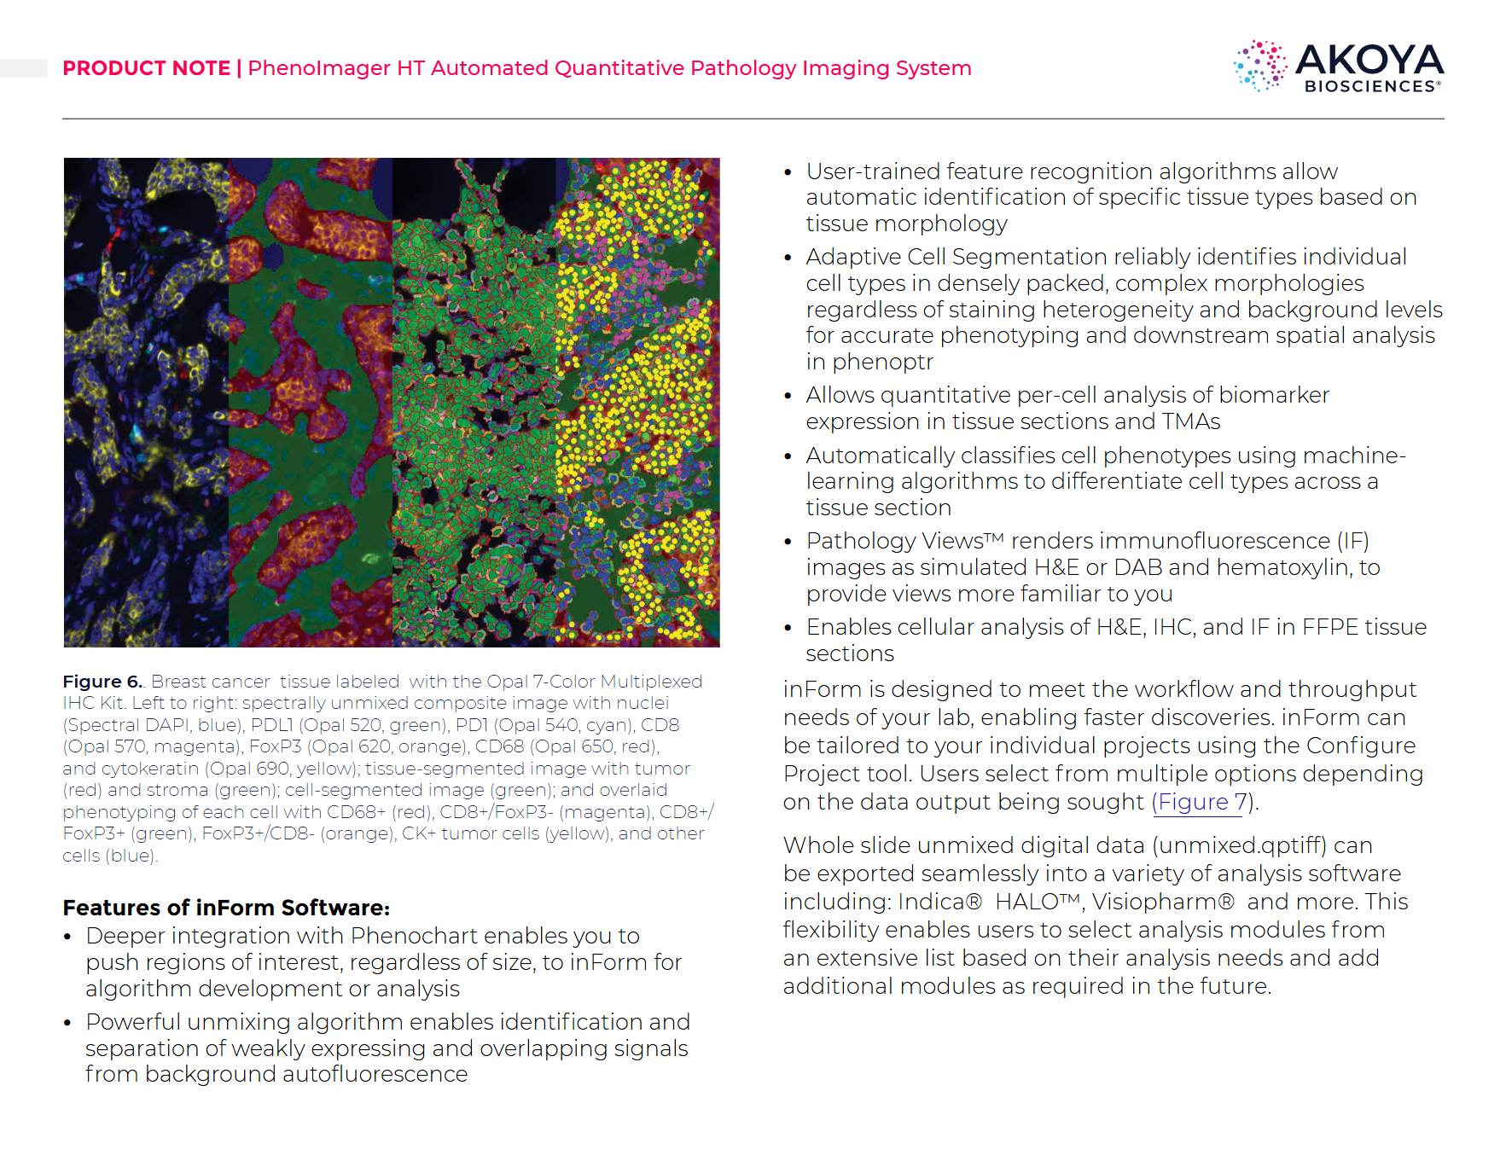


기존 Akoya Bioscience software 활용 과정
이는 "learn-by-example" 방식, 즉 사용자의 훈련이 필수적인 과정임
-> InForm 사용자 지정을 통한 ML 기능을 탑재
Vectra Polaris
여러 형광 물질로 염색된 조직 슬라이드를 스캔하여, 각 마커의 신호를 포함하는 다중 채널 고해상도 디지털 이미지를 생성
PhenoChart
선택된 관심 영역(ROI)을 컴퓨터가 분석하기 쉽도록
여러 개의 작은 정사각형("타일")으로 자동 분할
inForm
스펙트럼 분리
겹쳐있는 여려 형광 물질을 수학적으로 분리하여 각 마커(CD8, CD45 등)별로 독립된 순수 신호 채널로 만듦
Tissue Segmentation & Cell Detection
Gland
Stroma
Fibrous tissue
Blank
세포 표현형 분석
면역 세포, 증식 세포등 종류 결정 및 분류

Slide 2
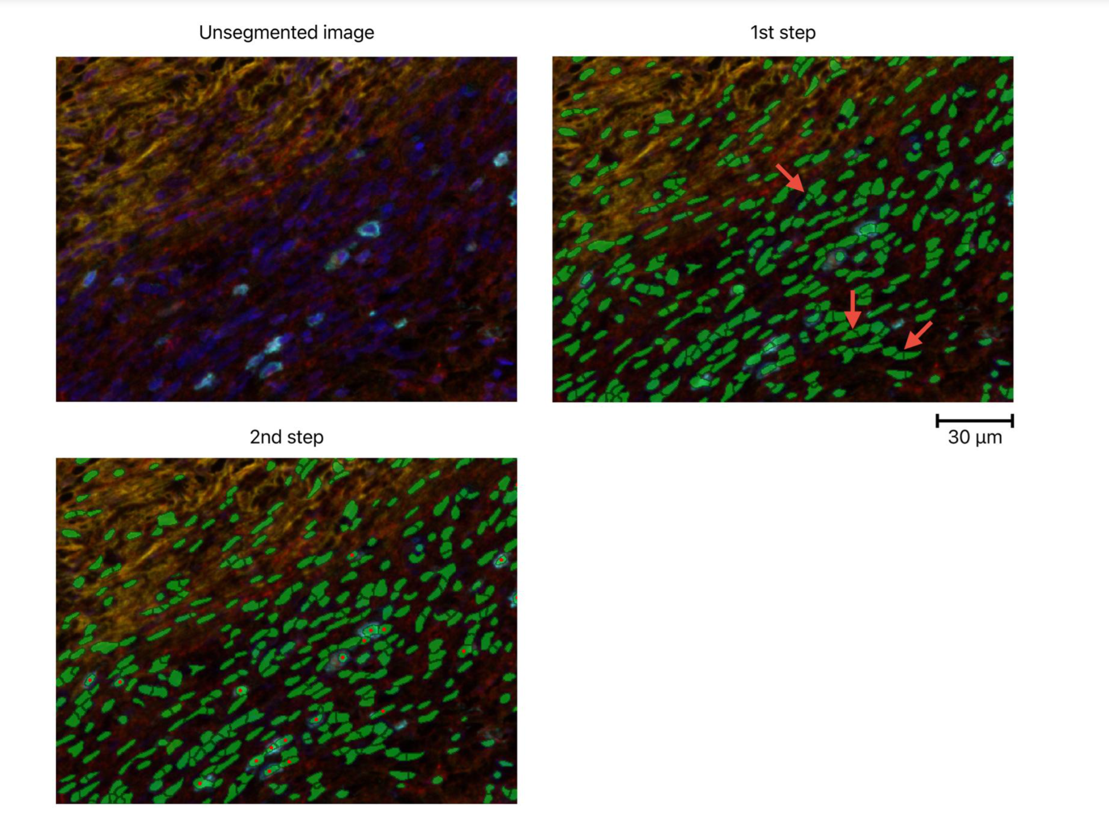
inForm
이 후 해당 결과를 통해 Spatial analysis를 진행.
To train the phenotype identification,
110 CD45+
and 110 other cells
Manually Trained

Slide 3
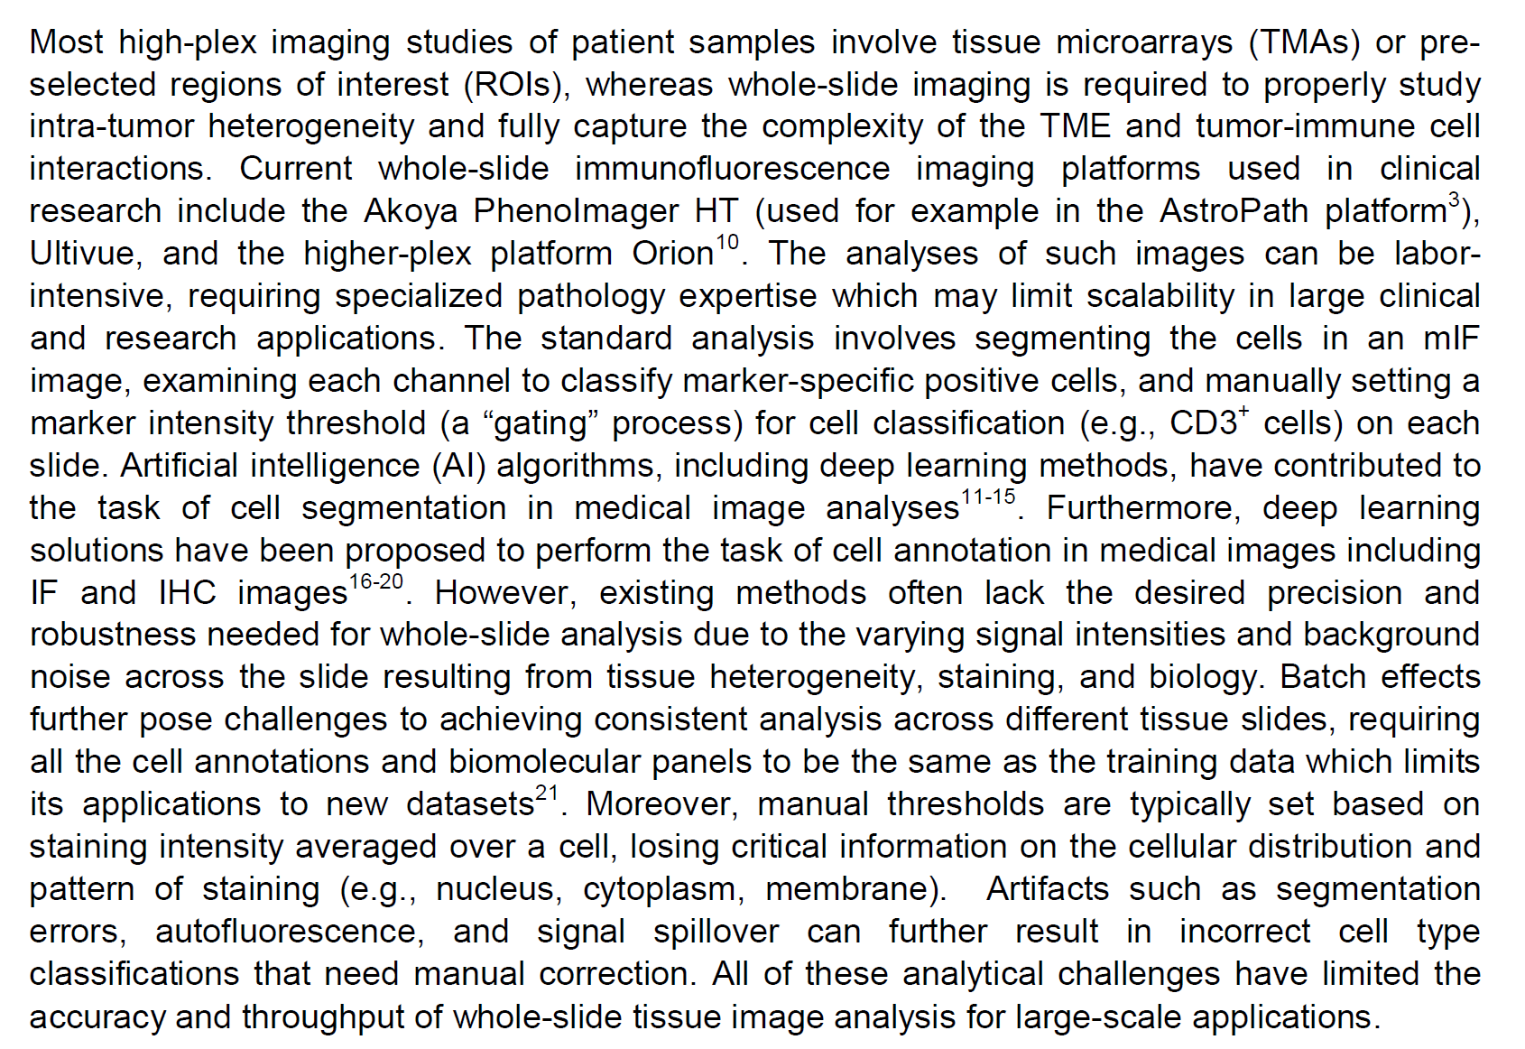
Results from Spatial Analysis
Proximity: How close are immune cells to tumor cells?
Neighborhood: Which cell types cluster together to form local communities?
Infiltration Pattern: Do immune cells infiltrate the tumor core, or are they restricted to the margins?
Density Distribution: Are specific cells enriched in certain regions, such as the epithelium versus the stroma?
WSI 분석의 필요성
Spatial Immunophenotyping from Whole-Slide Multiplexed Tissue Imaging Using Convolutional Neural Networks,2024

Slide 4
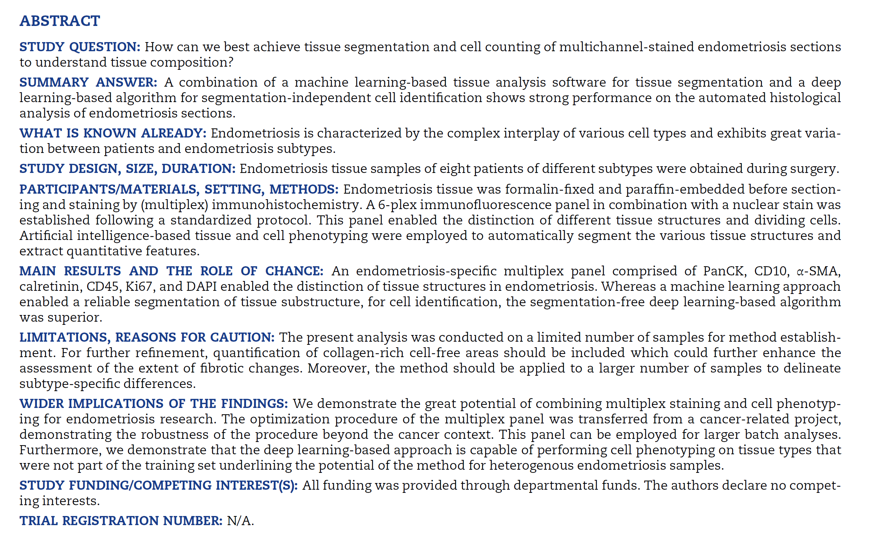
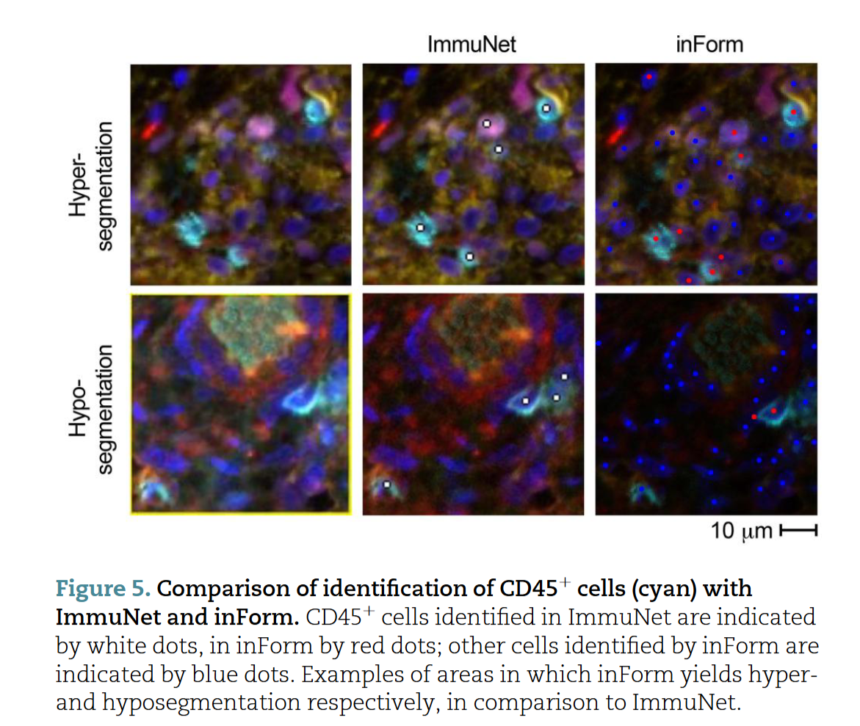
Artificial intelligence-based tissue segmentation and cellidentification in multiplex-stained histologicalendometriosis sections, 2024 Human Reproduction(IF:6.4),
MAIN RESULTS AND THE ROLE OF CHANCE
자궁내막증 분석을 위한 맞춤형 7-Plex 패널 개발
두 가지 AI 분석법 비교: 머신러닝(ML) vs. 딥러닝(DL)
조직 구조 분할 (Tissue Segmentation): 머신러닝(ML) 방식의 우수성 확인
개별 세포 식별 (Cell Identification): 딥러닝(DL) 방식의 압도적 우위
==>최종 결론: '하이브리드(Hybrid) AI 접근법'이 최적의 전략]

Slide 5
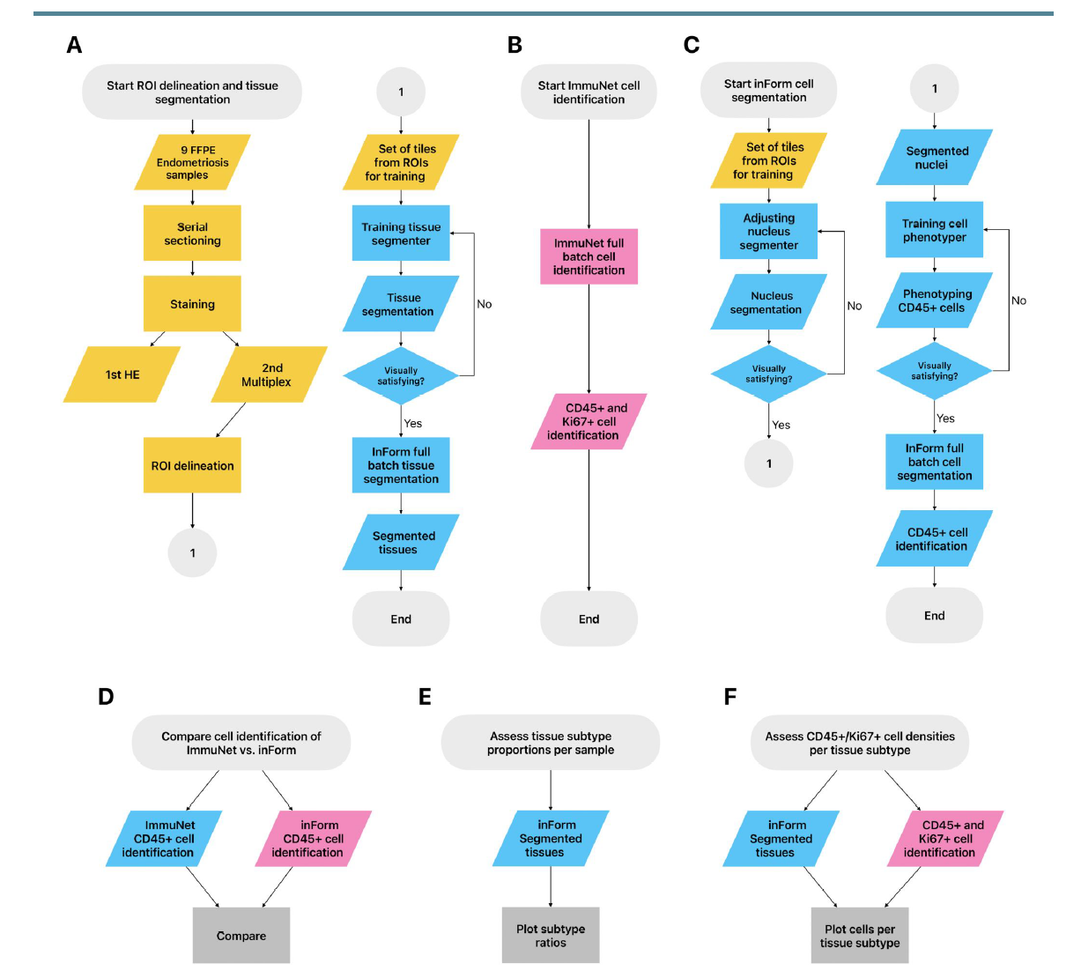

Slide 6
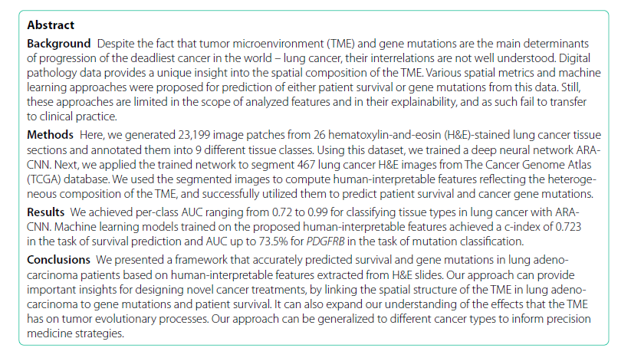
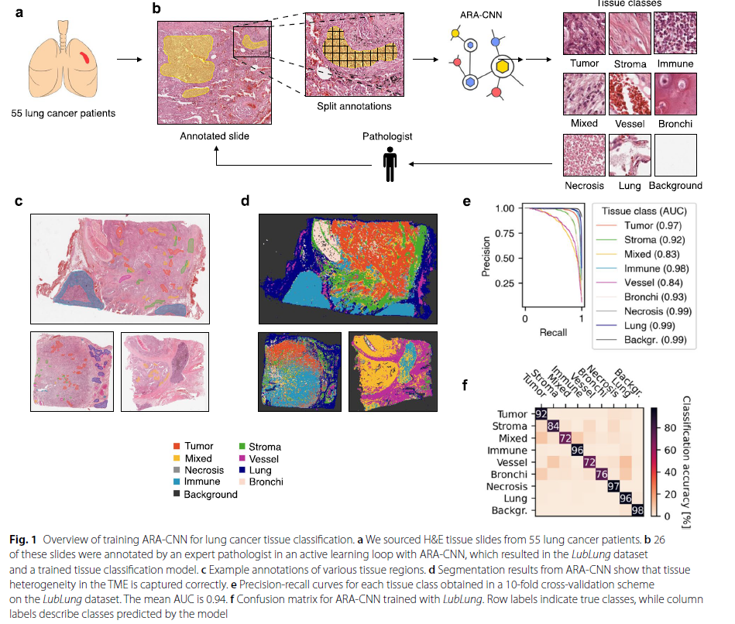
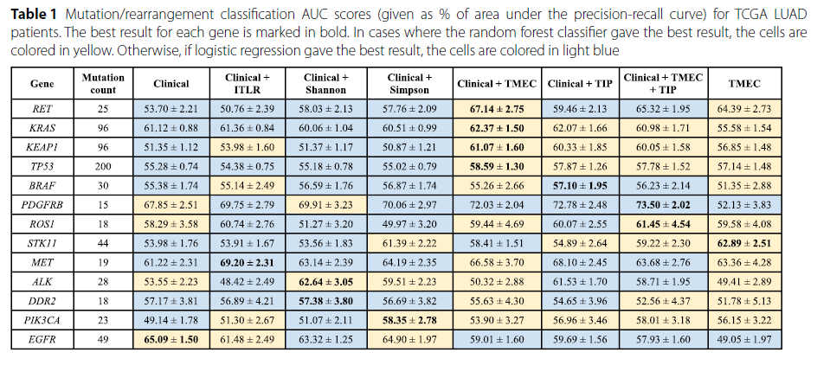
Deep learning‑based tumor microenvironment segmentation is predictive
of tumor mutations and patient survival in non‑small‑cell lung cancer, 2024 BMC Cancer,
TIP(Tissue Prevalance)
TME
Distribution of tissue clases within the whole tissue area, excluding the background class
TMEC(Tumor Microenvironment compostition)
A distribution of tissues that neighbor the tumor tissue within a predefined margin.

Slide 7
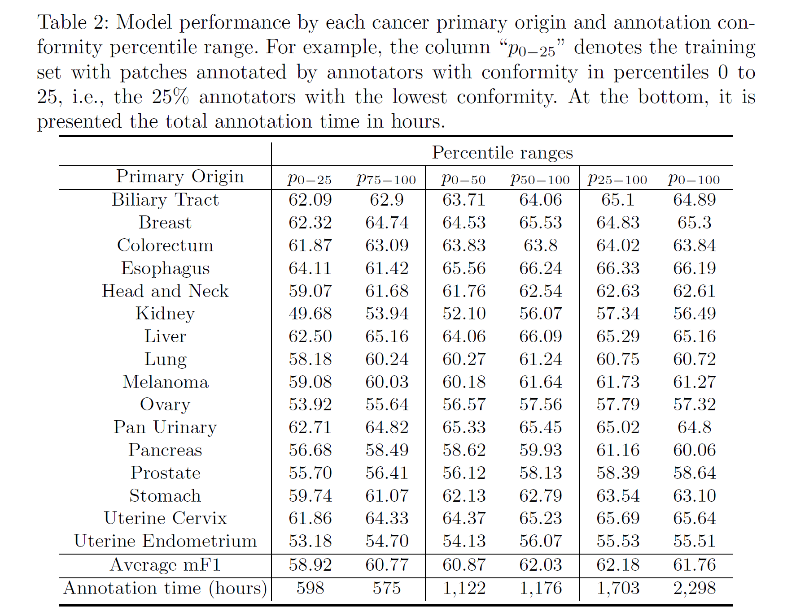
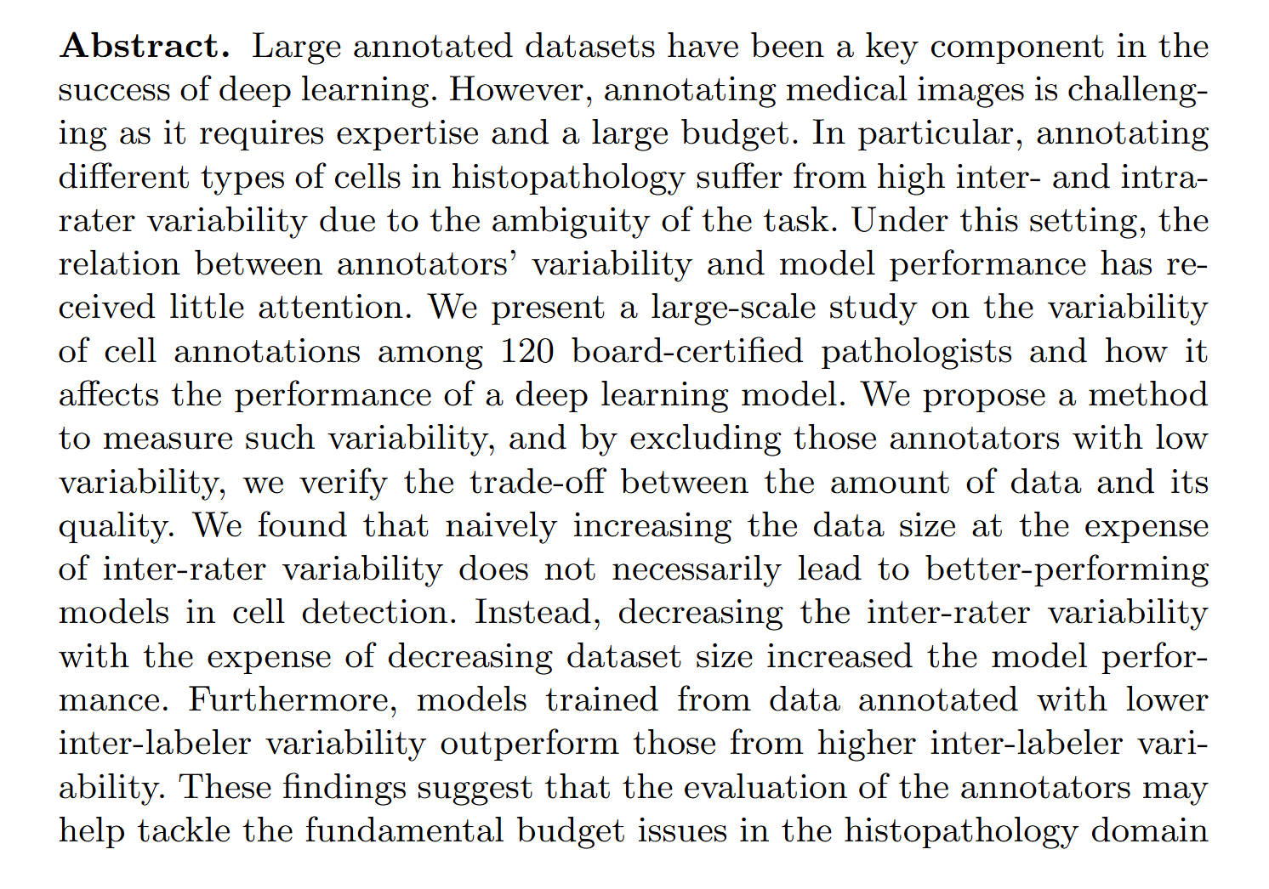
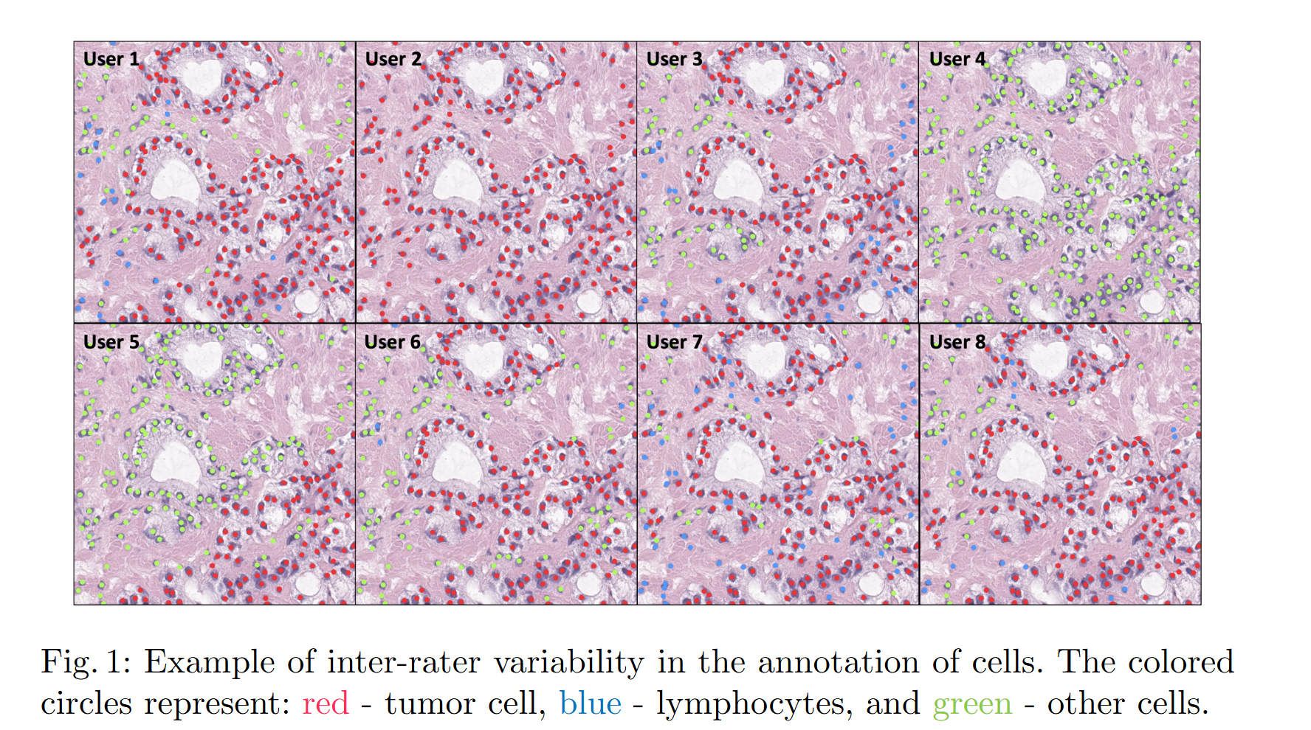






Variability Matters : Evaluating inter-rater variability in histopathology for robust cell detection, Computer Vision – ECCV 2022 Workshops, 2022
주석 일치도에 따른 성능 차이

Slide 8
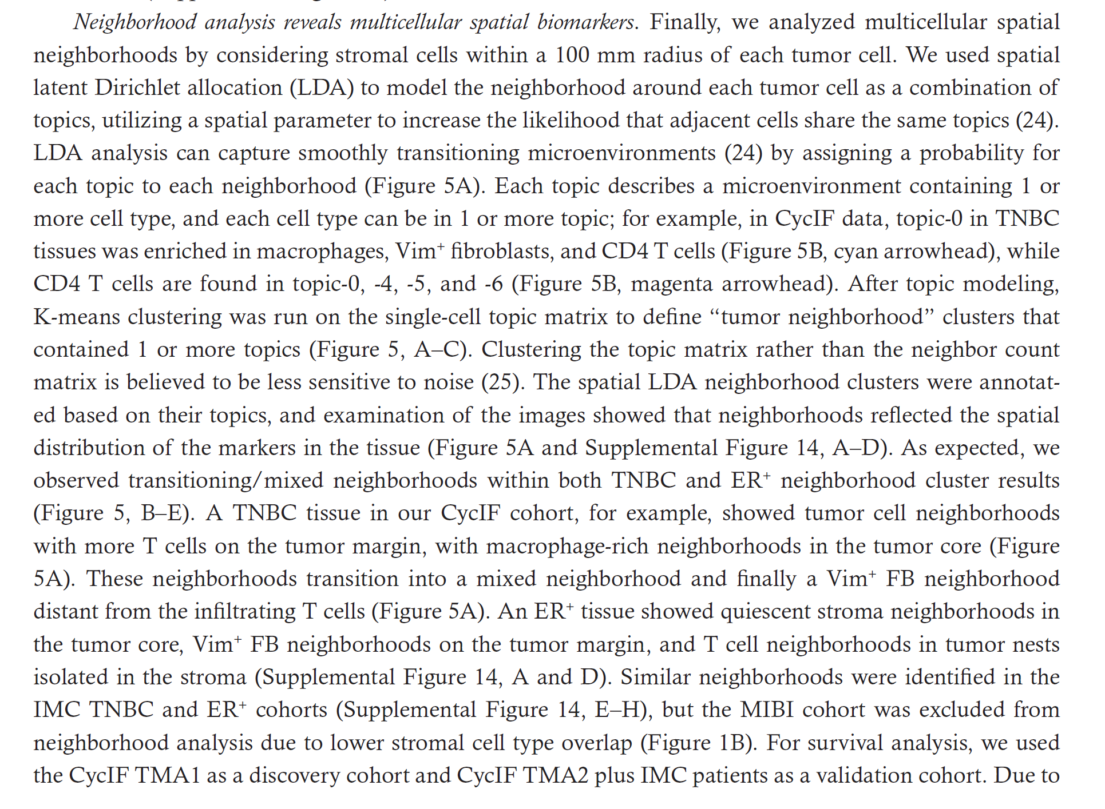
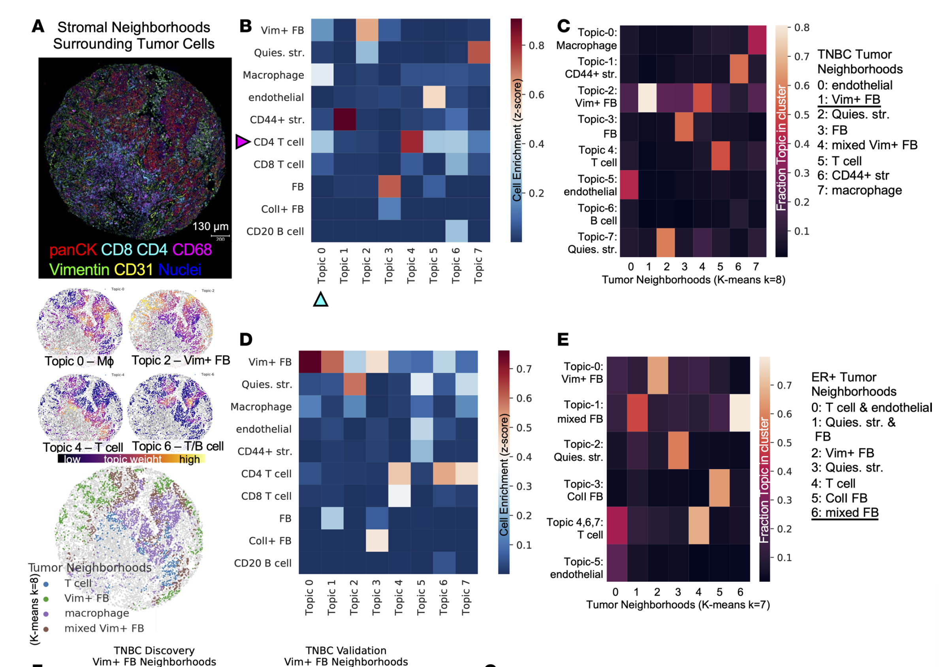
Highly multiplexed imaging reveals prognostic immune and stromal spatialbiomarkers in breast cancer

Slide 9
 | 전처리/ROI 선택 | 세포/조직 분석 | 공간 통계 분석 | 커스텀 딥러닝 모델 추가
상용 (Akoya) | PhenoChart | InForm | CytoMap, R, Python 등 | 불가 (내장된 머신러닝 알고리즘 사용)
상용 (Indica Labs) | HALO | HALO | (자체 공간 분석 기능 포함) CytoMap,R,Python 활용가능 | 불가 (내장된 AI 모듈을 학습시켜 사용)
Open Source | Orbit | ImageJ | CytoMap, R, Python 등 | 가능 (Script를 통해 자유롭게 추가 및 연동)
 | 외부 Python 라이브러리 | QuPath, CellProfiler | CytoMap, R, Python 등 | 가능 (Script를 통해 자유롭게 추가 및 연동)
Algorithm
Cell Segmentation | Tissue segmentation
Mesmer | U-Net
Cellpose | ViT(Vision Transformer)
StartDist | swin transformer

Slide 11
유료
무료
Software | Availability | Advanatageous
InForm | Classifying cellular phenotypes using machine learning algorithms and automatically detecting and segmenting specific tissue types based on tissue morphology | identifies and isolates weakly expressed and overlapping signals from background autofluorescence to obtain low phenotypic expression and is able to quantify staining levels.
CODEX | image alignment, segmentation, measurement, quantitative analysis, heat map analysis, cell counting and protein expression analysis, as well as cell sorting and filtering capabilities | high-plex (up-to 60 markers)
QuPath | Automatically recognises fluorescence and bright field views, enabling the detection of localised cells, positive cells and tissues using its built-in algorithms. | ideal choice for beginners
Orbit | quantifies high-resolution images, particularly large-sized, WSIs, and identifies regions of interest (ROIs). | Could be used to preprocess Image Data to run on ImageJ
HALO | optimized proprietary algorithms and trainable AI modules to perform rapid cell detection and segment diverse tissue classes based on morphology. uses a trainable machine learning algorithm to segment tissue compartments, creating an architectural map that enables detailed cellular analysis within specific regions. | All-in-One platform
ImageJ | optical density analysis, quantitative analysis, morphological analysis and colour analysis, as well as essential image processing functions | most flexible, widely used and long-standing biomedical image analysismacros or plug-ins for distribution, and many such specialised plug-ins exist for public use.

Slide 12
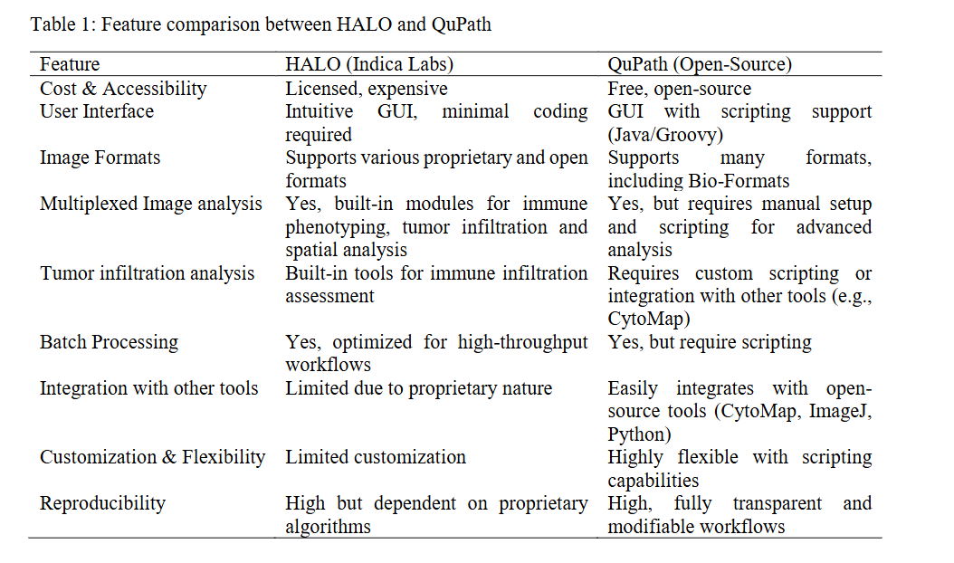
Comparison of QuPath and HALO platforms for analysis of the tumormicroenvironment in prostate cancer, bioRxiv

Slide 13
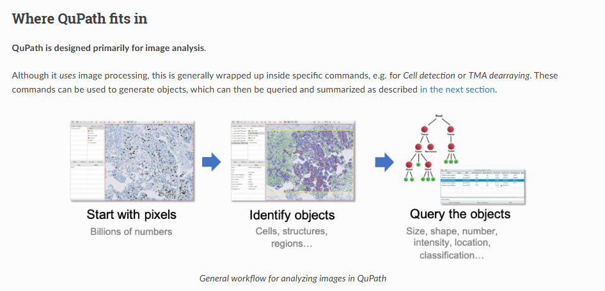
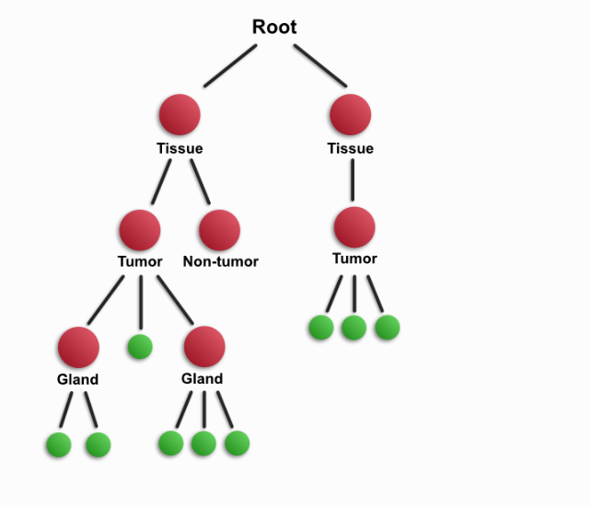

Slide 14
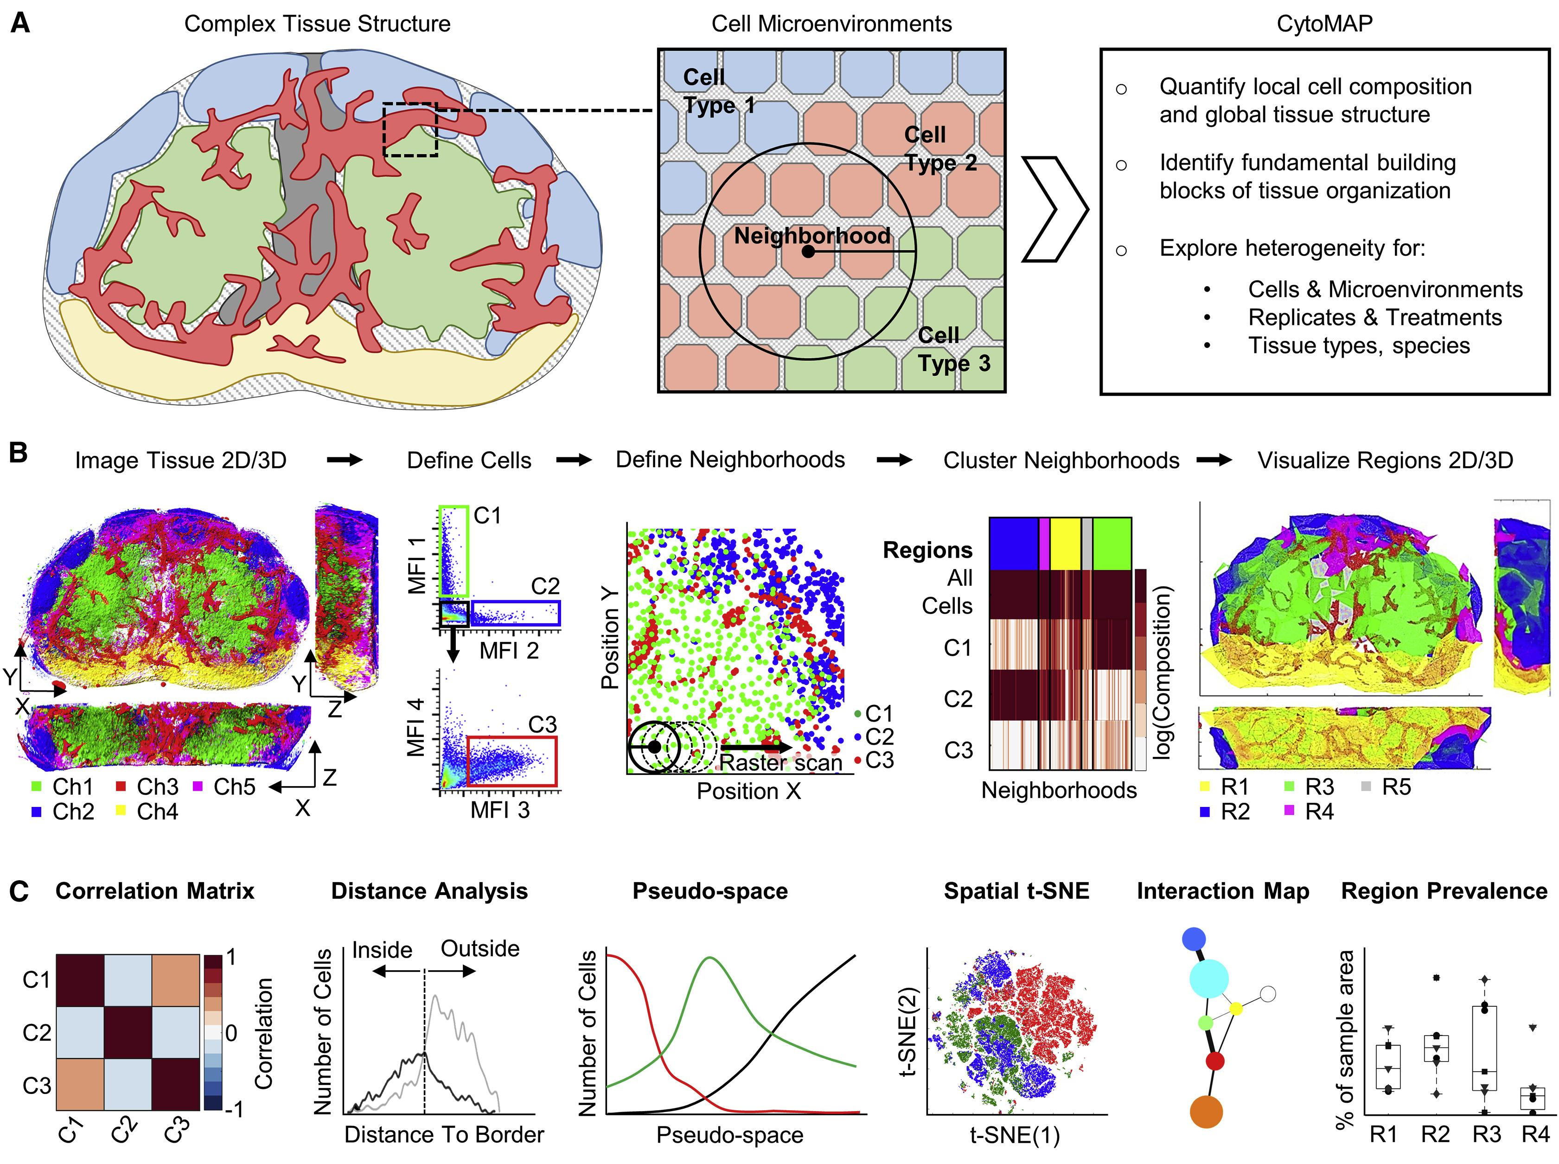
CytoMAP is designed to extract quantitative information on cellular localization and composition within tissue regions, revealing how local cell microenvironments form global tissue structure, as well as allowing comparison of intra- and inter-sample tissue heterogeneity

Slide 15
